Slide 2
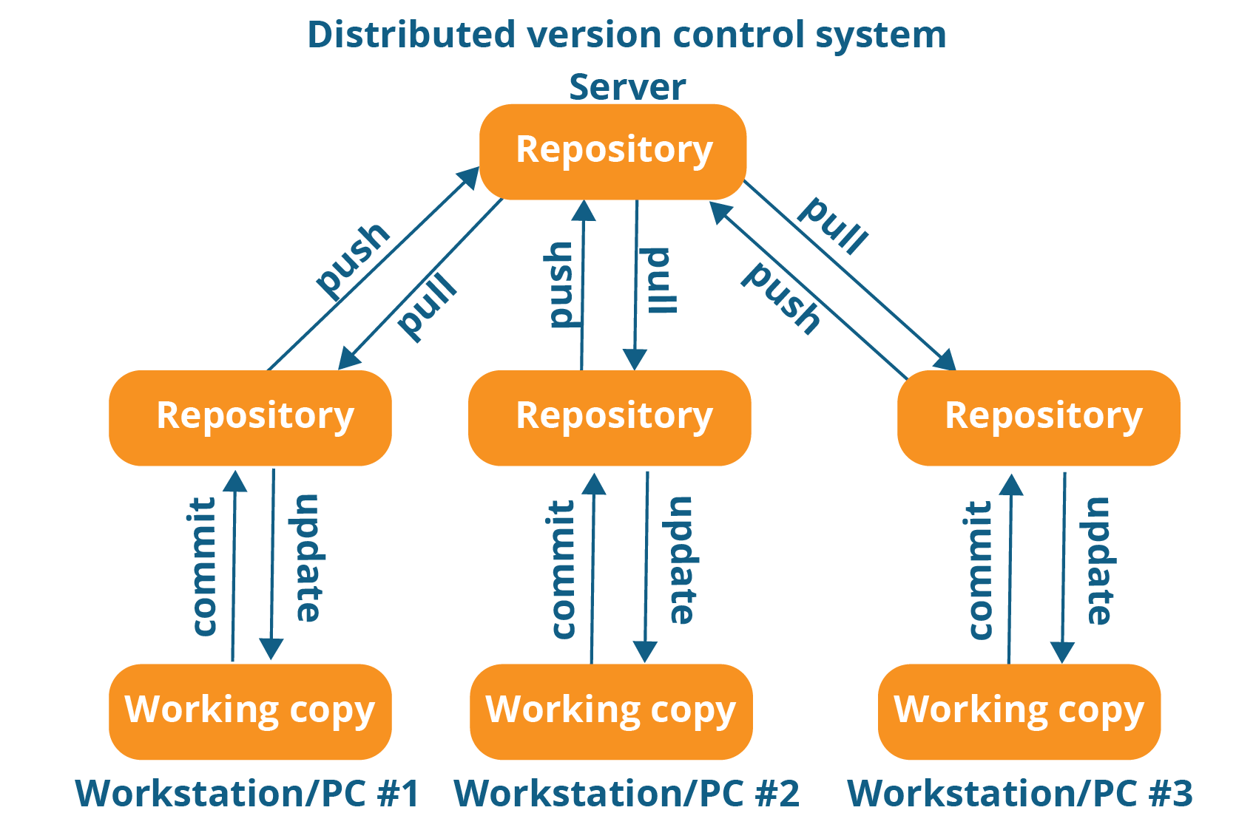
Version Control
Version control systems are a category of software tools that helps in recording changes made to files by keeping a track of modifications done in code.

Slide 3
Why Version Control System?
Most software are not developed by single developer, instead by teams collaborating with each other.
There are can be multiple of teams containing multiple person.
Ex:-
Team of developer
Team of tester
Team of DevOps etc

Slide 4
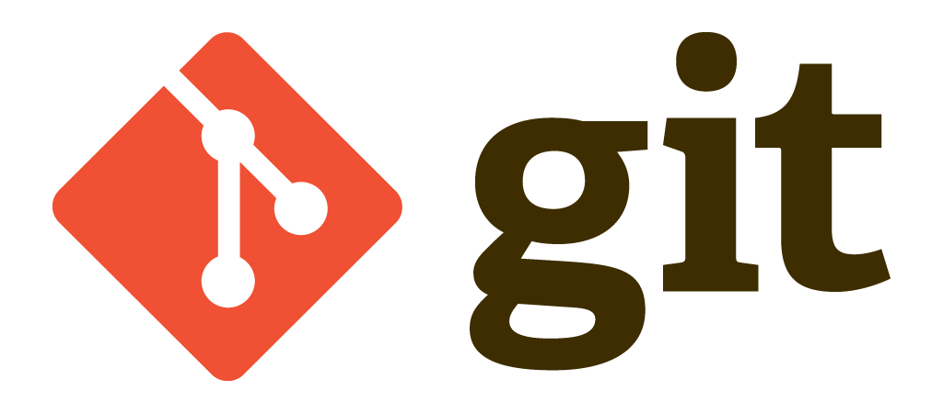
How?
Git

Slide 5
History
It was developed by Linus Torvalds (Creator of Linux OS)
There were large amount of contributor to the Linux to deal with this BitKeeper was used
BitKeeper was propritary source control management system which means they have to pay for the use of Tool
And more
At the end Git was developed by Linus Torvalds

Slide 6
About Git?
Git is free and open-source distributed version control system designed to handle everything from small to very large projects with speed and efficienc.
Initially designed and developed by Linus Torvalds for Linux kernel development in 2005.
Git allows a team of people to work together, all using the same files. And it helps the team cope up with the confusion that tends to happen when multiple people are editing the same files.

Slide 7
Now The Fun Part

Slide 8
Where to install git
Git (git-scm.com)
Search Git
Download for your os
Run executable and install

Slide 9
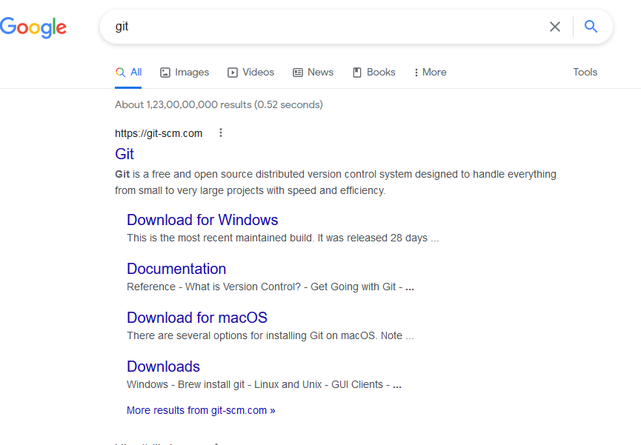

Slide 10
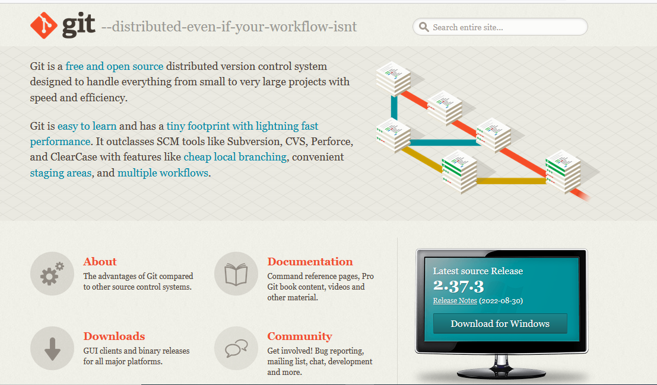

Slide 11
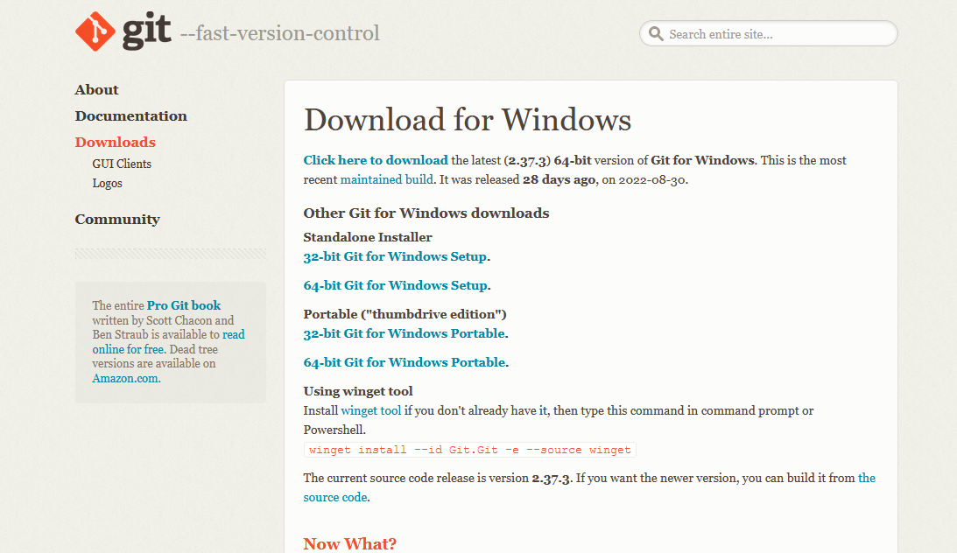

Slide 12
Cloud Distributer
Github
Gitlab
GitBucket
You can create account on any of these.
I Prefer github

Slide 13


